Slide 1

Pima Indians Diabetes Dataset Analysis: From Exploration to Prediction
This presentation covers analysis of the Pima Indians Diabetes dataset. We explore data, clean it, build models, and evaluate results. The goal: develop predictive machine learning models to identify diabetes onset accurately.
RC
by Rini Chhabra

Slide 2
Exploratory Data Analysis (EDA): Unveiling Insights
Dataset Overview
Missing Values
768 samples, 9 variables: 8 features plus outcome.
Noticed zeroes in key features like Glucose and Blood Pressure.
Features: Pregnancies, Glucose, Blood Pressure, Skin Thickness
These indicate missing or invalid data points requiring correction.
Insulin, BMI, Diabetes Pedigree Function, Age
Target: Outcome (Diabetic or Non-diabetic)

Slide 3

Data Cleaning and Preprocessing
Missing Data Imputation
Outlier Handling
Applied mean or median imputation for zero-valued features.
Detected outliers and adjusted to reduce model bias.
Feature Scaling
Data Split
Used StandardScaler/MinMaxScaler for algorithm compatibility.
Train-test split 80/20 with stratified sampling.

Slide 4
Data Visualization: Patterns and Relationships
Histograms & Boxplots
Correlation Heatmap
Pairplot
Show distributions, feature skewness, and outliers.
Strong link seen between Glucose levels and diabetes outcome.
Visualizes feature relationships colored by diabetic status.

Slide 5

Model Implementation: Algorithms and Parameters
Logistic Regression
Regularization (L1/L2), solver tuning.
K-Nearest Neighbors
Optimal k selected via cross-validation.
Decision Tree & Random Forest
Tuning max_depth, n_estimators to control overfitting.
SVM & Naive Bayes
Kernel and hyperparameters refined; Gaussian Naive Bayes applied.
XG Boost
Fast gradient boosting model added for performance comparison. Plotted AUC: ~0.80.

Slide 6
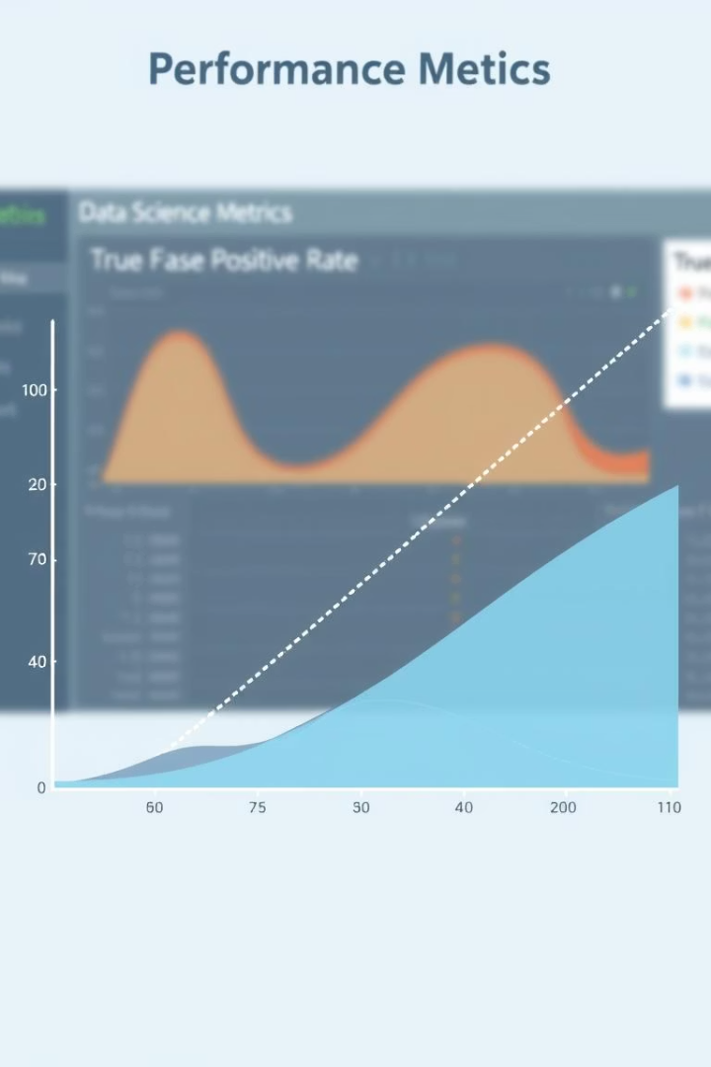
Model Evaluation Metrics
Accuracy & Precision
Recall & F1-Score
Capture true positives; balance precision and recall.
Measures overall correctness and false-positive control.
ROC & AUC
Visualize and quantify model's true-positive vs false-positive rates.

Slide 7
Comparative Model Performance: ROC Curve & AUC Scores
Naive Bayes
Random Forest
Logistic Regression & SVM
Decision Tree
Highest AUC: 0.83, best discrimination ability.
AUC: 0.82, strong ensemble model performance.
Lowest AUC at 0.72, prone to overfitting.
Both scored an AUC of 0.81, competitive results.

Slide 8





Conclusion: Insights and Implications
Top Performer: Naive Bayes
Best AUC and robust outcomes on this dataset.
Key Features
Glucose, BMI, Age, and Diabetes Pedigree crucial predictors.
Future Improvements
Hyperparameter tuning and ensemble enhancements suggested.
Next Steps
External validation, feature engineering, and clinical adoption.

